Slide 1
Lesson Overview
At the beginning of class, the new class criteria should be up. No need to discuss them just have them visible!
What we figured out and what we still don’t know (10min)-- have a discussion about what we know to date and what we still need to find out. (this is similar to yesterday’s discussion)
Give out the new handout and do the Stop & Think (2min for writing). No need to discuss they will be seeing evidence about this over the next 2 days
MEME (15min)-- have groups go on MEME and fix their models based on comments they received and the discussion. Please make sure to tell then NOT to delete comments.
MEME Simulations (20min)-- have groups continue on MEME and work with the new simulation
Before you go (3min)
Total time- 50 mins.

Slide 2
LESSON 4 - DAY 1

Slide 3


What have we figured out about how decomposers relate to the fish dying?
Decomposers use up air when breaking down dead matter
Decomposers get energy from breaking down dead matter
After the algae bloomed there was a lot of dead matter all of a sudden
This allowed decomposers to grow and multiply and they used more air
Eventually there was no air for the fish
Notes:
What questions do we still have? SLIDE IS ANIMATED – what we know appears on click
Ask students what do we know to date from the evidence about DECOMPOSERS (we know a lot of things, but we want to focus on decomposers.
We know the break down dead matter (please use break down language not eating language…they don’t technically ingest the dead matter- they get energy from breaking down dead matter
They use up air when doing that
The algae bloomed and so there was a lot of dead matter (once they started dying) and that allowed for more decomposers
More decomposers means less air and eventually fish died

Slide 4

What questions do we still have?
Why was there so much algae all of a sudden?
What caused this algal bloom?
Notes:
What questions do we still have? SLIDE IS ANIMATED – questions appear on click
Main questions are – why did the algae bloom ALL OF A SUDDEN?

Slide 5
STOP & THINK!
Grab handout 1 and put your name and information on the top of the first page.
Complete the STOP & THINK! question on the first page.
Think about all the different kinds of things that might be affecting algae.
What do you think might be causing the algae to grow so much?
Notes:
Handout the new handout and have students do the Stop & Think.
No need to have a discussion here its just to get them thinking about algae as they will be seeing evidence about this over the next two days

Slide 6
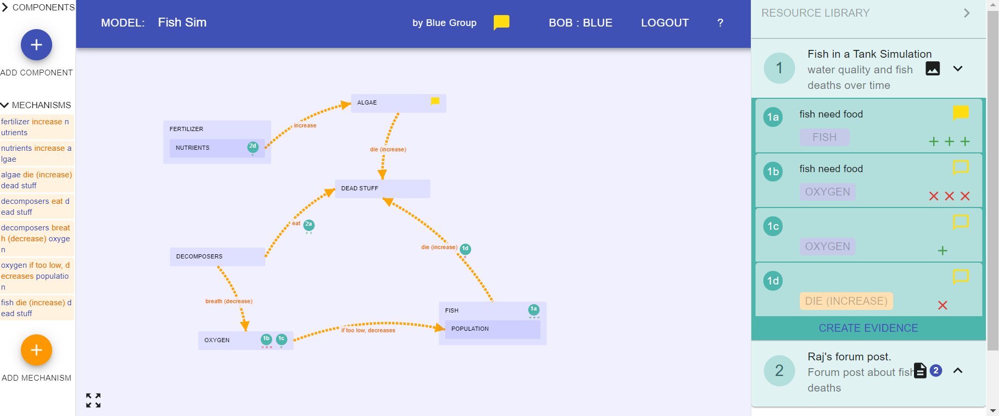







MEME: Update Model
Revise your model based on the comments you received from other groups. Do NOT delete comments!
Revise it based on what we figured out
Make sure your model meets the new class criteria.
Dead Fish
Notes:
Instruction
Explain that we need to update our models based on the evidence we studied and our discussion just now AND based on comments our peers gave us. So the students should spend pretty much rest of the period working on their MEME models and attending to comments–
fixing their models based on suggestions.
Fixing their models based on the discussion
Model also needs to meet the new and revised criteria!
Materials
Hand out computers.

Slide 7

MEME
Now we will look at a new simulation.
What important evidence can you make based on this simulation?
Do you need to revise your model?
Make sure you answer the questions on your handout!
Notes:
Tell students that we will look at a new simulation. The simulation will look similar to the ones we have already seen. There will still be the “pond” and the graphs, and they will still be able to change things to make things happen but in this simulation, they will work with different inputs or options to make different outputs or consequences
Remind students to think about important pieces of evidence that they might want to save to the resource library. Tell students: thank-does this part of the simulation support a piece of my model? Tell students that they also might learn new information that means they need to change the model. Remind them Of good conversation skills so that everybody has a chance to speak and be heard. If they are making a change to the model remind them that it needs to be clear, makes sense, and general effect with the class criteria. The model revisions also need to fit with the evidence, which means I need to be supported by evidence.
Also remind students to answer the questions on their hand out as they are working. These are important because they help to direct them to pieces of information

Slide 8
MEME
Try to use the simulation to figure out what is causing the algae to grow so much. Run the trials below keeping fish, algae the same and decomposers on
Nutrients Trial:
Click “Reset”
Set the nutrients to low. Run the simulation.
Now, set the nutrients to medium. Run the simulation again.
Now, set the nutrients to high. Run the simulation again.
Sunlight Trial:
Click “Reset”
Set the sunlight to low. Run the simulation.
Now, set the sunlight to medium. Run the simulation again.
Now, set the sunlight to high. Run the simulation again.
Dissolved Air Trial:
Click “Reset”
Set the dissolved air per tick to 0. Run the simulation.
Now, set the dissolved air per tick to 50. Run the simulation again.
Now, set the dissolved air per tick to 100. Run the simulation again.
Notes:
Tell students that we will look at a new simulation. The simulation will look similar to the ones we have already seen. There will still be the “pond” and the graphs, and they will still be able to change things to make things happen but in this simulation, they will work with different inputs or options to make different outputs or consequences
Remind students to think about important pieces of evidence that they might want to save to the resource library. Tell students: thank-does this part of the simulation support a piece of my model? Tell students that they also might learn new information that means they need to change the model. Remind them Of good conversation skills so that everybody has a chance to speak and be heard. If they are making a change to the model remind them that it needs to be clear, makes sense, and general effect with the class criteria. The model revisions also need to fit with the evidence, which means I need to be supported by evidence.
Also remind students to answer the questions on their hand out as they are working. These are important because they help to direct them to pieces of information

Slide 9
BEFORE YOU GO
Complete the BEFORE YOU GO questions.
Remember we talked about good discussions?
Think about the discussions you’ve had with your group today. Was your discussion :
poor, good, very good
(circle one)
How do you know?
Notes:
END OF DAY 1
Use this “Before You Go” as an exit ticket.
Do not hold a class discussion at this point, and keep it brief at the end of class.

